Slide 1
Dans Ship Board Net
Keeping the Full Sail on course

Slide 2
Components
Componet | Role | Cost | Draw/mA | Vendor | Notes
RaspberryPi 3 B+ | Core computer system | $ 30.00 | 1400 | MicroCenter
Globalsat BU-353-S4 | GPS | $ 30.00 | 55 | Amazon
dAisy AIS 2+ Reciver | AIS | $ 89.00 | 20 | Wegmatt (Tindie.com) | without +2 removes the NMEA 0183 and cost $59 or as RPI Hat @ $65
AIS Antenna | Antenna | $ 30.00 | 0 |  | Various suppliers (range from $15 - 200)
Display | 7" Touch Screen Display | $ 59.00 | 1800 | Microcenter | (Display is not needed for Wireless operation but some display & KB will be needed to setup)
Tripmate Nano | Central Connection | $ 20.00 | 500 | Amazon | HooToo Wireless Travel Router with 10400 mA Battery N300 $40
Buck Power (8-35v) - USB |  | $ 10.00 |  | Amazon | up to 8000mA supply
OpenPlotter | Core Software | $ - |  | http://www.sailoog.com/openplotter
Micro SD Card | Mass Storage | $ 10.00 |  | Many | Min is 8GB no Max I use 32Gb based on price
Maps | US Maps | $ - |  |  | Downloadable
USB Cables | power connections | $ 10.00 |  | Many | USB A to Mico fro dAISy and HooToo USB A to mini for PI
Ubiquiti Bullet M BM2HP | LR Wifi | $ 80.00 | 7000 | optional | Long Range WiFi reciver up to 50km
Totals |  | $ 368.00 | 10775 |  | 3.8 A @ 5v

Slide 3
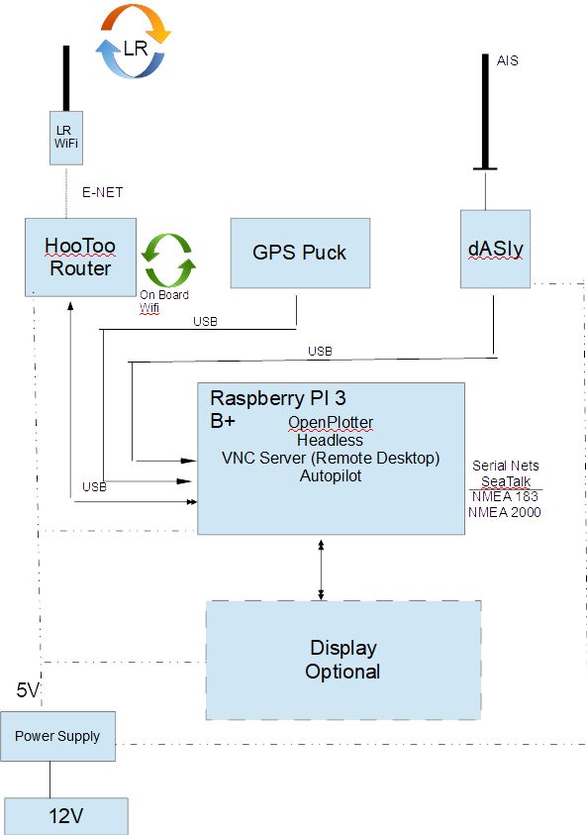
Interconnect
Core of the Plotter is an ARM based Raspberry Pi running Linux and the Openplotter software load.
Full Sail has a built in 7” touch screen display located at Nav station, but normal access is via iPad using RealVnc app
The HooToo router provides on-board Wi-Fi and allows mobile devices to act as remote desktop access to the system.
The dAISy device provides AIS info
The GPS puck provides Lat/Long
The Pi provides serial IO to the various seatalk and NMEA networks
A LR Wi-Fi receiver connects to the on-board router to supply INET from up to 30 miles away

